Slide 1
Linear algebra:
Projections onto subspaces
主讲人：常万里

Slide 2

Reference
MIT 18.06 Linear Algebra
https://ocw.mit.edu/courses/mathematics/18-06-linear-algebra-spring-2010/
http://open.163.com/special/opencourse/daishu.html

Slide 3
Index
Projections
Projection matrix
Why project ?
Projection in higher dimensions

Slide 4
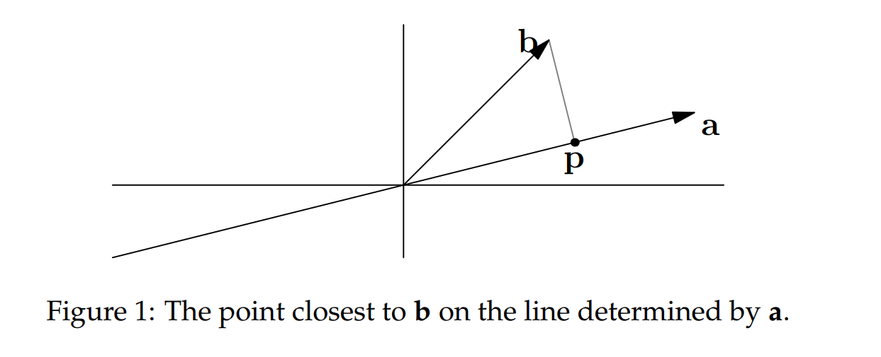
Projections
If we have a vector b and a line determined by a vector a, how do we find the point on the line that is closest to b?

Slide 5
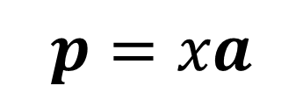
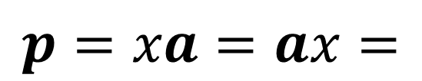

$$p=xa$$
$$e=b−xa$$
How to get x?
$$p=xa=ax=$$
Notes:
a^{T}(b ⁻ xa) = 0
xa^{T}a = a^{T}b

Slide 6
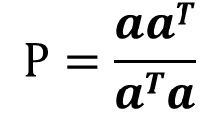
Projection matrix
We’d like to write this projection in terms of a projection matrix P : $p=Pb$
$$P=\frac{aaT}{aTa}$$
matrix
number
Property:
Rank (p) = 1
P^{T} = P
P² = P

Slide 7


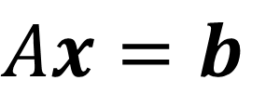
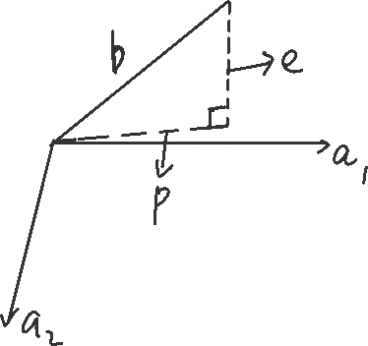
Why project ?
$$Ax=b$$
may have no solution
Instead
$$A\hat{x}=p$$

Slide 8
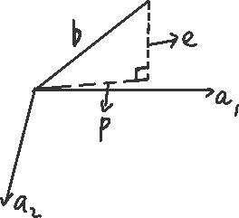
Projection in higher dimensions
Notes:
$$A=\left[a_{1},a_{2}\right]$$
$p={\hat{x}}_{1}a_{1}+{\hat{x}}_{2}a_{2}$
$A\hat{x}=p$
e = b ⁻ p = b ⁻ $A\hat{x}$

Slide 9

Notes:
Trans(a1)垂直于e，
Trans(a2)垂直于e，
所以trans(A)垂直于e,
A^{T}Axˆ = A^{T}b.
xˆ = (A^{T}A)−¹ A^{T}b
p=Ax =Proj*b
Proj=?

Slide 10
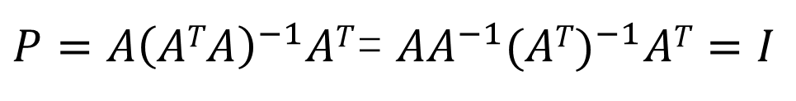
?
${P=A\left(ATA\right)}^{−1}AT$= ${AA}^{−1}{(AT)}^{−1}AT=I$
P^{T} = P
P² = P
Notes:
A不可逆

